Slide 1
Compassionate Friends Making a difference in a school setting
Compassionate
Friends Making a difference in a school and college setting
Community Development Team
St Luke’s Hospice Plymouth
community.development@stlukes-hospice.org.uk
Notes:
Welcome and introductions (go around the room asking people to introduce themselves – name, role, which school and why they have attended the session today).
This Compassionate Friends ‘making a difference in a school and college setting’ session has been put together by St Luke’s as part of their Compassionate Schools programme.

Slide 2
Group Agreement
Notes:
Before we start, we need to agree how we want to work as a group during this session to ensure:
It is an open and respectful environment.
All feel safe to share ideas and opinions.
Examples – respecting other people’s opinions, provide an opportunity for all to speak, remain confidential (especially around colleagues and students).

Slide 3
St Luke’s Hospice Plymouth
We provide specialist end of life care and support to people from across Plymouth, South West Devon and East Cornwall, whether in the home, hospital or at our specialist unit at Turnchapel
We care for people over the age of 18 with serious illnesses such as cancer, motor neurone disease, heart failure, multiple sclerosis and chronic lung disease
We respect patients’ individual rights and religious and cultural beliefs
We have a dedicated Patches Family & Children’s Support Worker that provides tailored support to children
Notes:
For over 40 years St Luke’s Hospice have been providing specialist end of life care and support to people from across Plymouth, South West Devon and East Cornwall.
Of the patients St Luke’s cared for last year (2022), 57% of those were cared for at home, 35% at Derriford Hospital and 8% at Turnchapel.
St Luke’s home team (nurses, social workers and occupational therapists) offer specialist advice, care and support to people with progressive life limiting illnesses in the comfort of their home (excluding East Cornwall).
St Luke’s hospital team provides a specialist care service to Derriford Hospital, seven days a week, across every ward in the hospital. The core team is made up of two doctors, six nurses and administration support.
St Luke’s specialist unit is based at Turnchapel which has 12 patient beds (single and multiple bedded rooms). The beds are intended for patients with complex needs that are providing difficult to manage in other settings. The unit is not a long stay – once symptoms or other issues have been satisfactorily addressed, patients will be discharged home or to another setting.
St Luke’s care for people with serious illnesses such as cancer, motor neurone disease, heart failure, multiple sclerosis and chronic lung disease, treating any adult over the age of 18.
St Luke’s respect patients’ individual rights and religious and cultural beliefs.
St Luke’s has a dedicated Patches Family and Children’s Support Worker available that comes alongside families, to get to know them and understand their particular circumstances. The team can then develop tailored support to help the child/children understand what is happening in a way that is most appropriate for them.

Slide 4
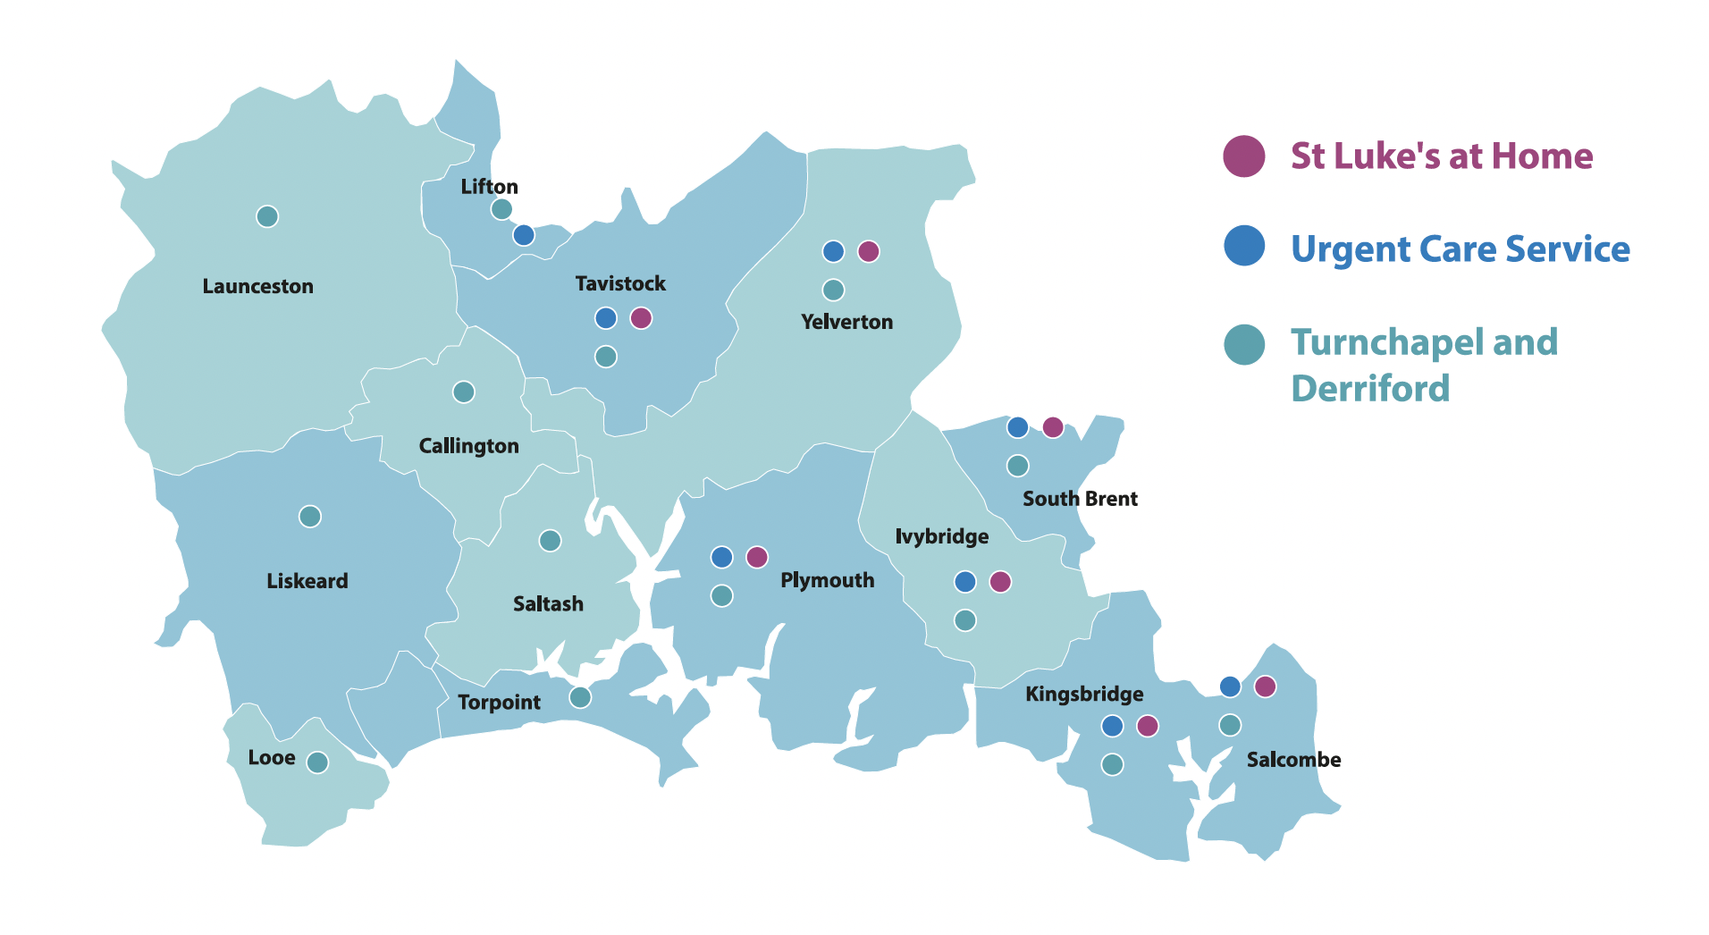
The area we cover
Notes:
This map shows you where St Luke’s delivers its care – a vase geographical patch covering Plymouth, East Cornwall and West Devon! Currently, the ‘Home’ team do not provide home care to those living in Cornwall, however this is something St Luke’s are striving to do in the future. They can still access all St Luke’s services including Patches.

Slide 5
Community Development
What are Compassionate Communities?
Compassionate Communities is an international
moment which recognises that caring for one
another at times of crisis and loss is everyone’s
responsibility as a public health issue (not
tasked solely for health and social services).
Where are Compassionate Communities?
The places in which we live, work, play, learn and
pray are the micro communities that have capacity to offer emotional and practical support for those that have a serious illness/end of life and those bereaved at any age.
The role of schools/colleges:
To ensure that those children, young people and the wider school community who has dying parents, siblings, grandparents, loved ones and those that are experiencing loss and bereavement, feel supported by the school/college and their peers.
Notes:
A Compassionate Community gives ‘ordinary’ people the skills to be able to address issues raised by end of life, life limiting illnesses and other losses, and to be a helpful, empathic ear.
A community is not just a geographic community, but also clubs, schools, churches, workplaces etc (where people come together).
The role for schools/colleges - to ensure that those children, young people and the wider school community who has dying parents, siblings, grandparents, loved ones and those that are experiencing loss and bereavement, feel supported by the school/college and their peers.

Slide 6
Plymouth, the first Compassionate City
in England
A compassionate city is a community that recognises that care for one another at times of crisis and loss is not simply a task solely for health and social services but is everyone’s responsibility.
At a conference held in Plymouth in 2018, schools, GP surgeries, solicitors and charities and many other organisations and groups – called for our city to have an End of Life Compassionate City Network and all agreed the following vision:
Plymouth will not shy away from the taboo subject of death, but talks openly about it, in order to create a city that is truly informed and compassionate towards those facing end of life or experiencing loss and bereavement.
We will create a Compassionate City by working towards the international Compassionate City End of Life Charter.
Notes:
1 of the 11 Plymouth Compassionate City charter points (which also includes workplaces, places of worship, hospices and nursing homes etc) is schools and colleges.
The schools and colleges objective seeks to ensure that those children, young people and the wider school community who have dying parents/loved ones and who are experiencing loss and bereavement, feel supported by the school and their peers.
Teachers have often said that children affected by death, loss and bereavement need somewhere in school to talk as they feel they cannot always talk about it at home sometimes for fear of upsetting the adults and family members.

Slide 7
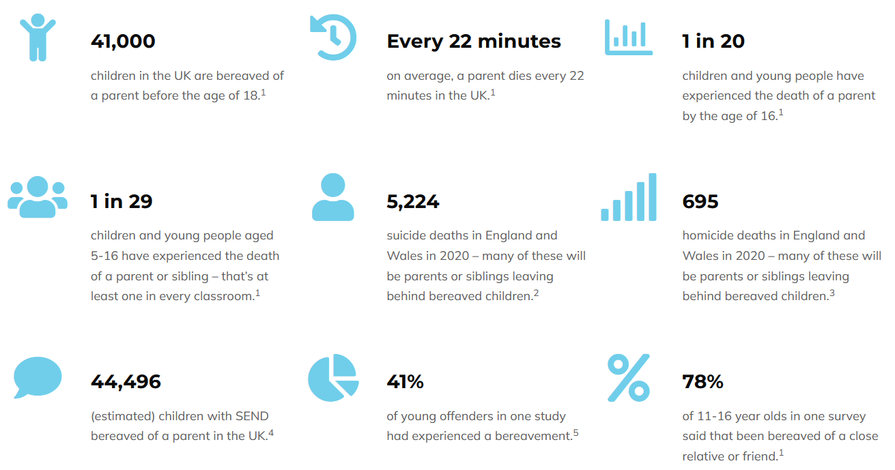
Childhood bereavement statistics for the UK
¹ Childhood Bereavement Network, Childhood bereavement: what do we know in 2019
² Office for National Statistics, Suicide in England and Wales: 2020 registrations
³ Office for National Statistics, Homicide in England and Wales: year ending March 2020
⁴ There are an estimated 309,000 bereaved children in the UK (Childhood Bereavement Network)
⁵ Higgins, B (2001), The Health Needs of Young People who Offend, Youth Justice Trust
Notes:
No one knows exactly how many children are bereaved every year because that data is not collected. Even though the death of parent is one of the most devastating losses a child will ever face.
In the absence of official data, the following statistics are based on mortality figures, census data and other sources.
41,000 - That’s more than 100 children and young people are bereaved of a parent every single day in the UK.
Bereaved children and young people often feel isolated and alone. They can experience grief and loss reactions such as anxiety, depressive symptoms, fears and angry outbursts that can lead them to feeling cut off from their friends and family. They could also exhibit changes of behaviour, which could significantly impact on their school life. A bereaved child may also experience regression of developmental milestones and lower self-esteem at school, which could put them at greater risk of mental health issues such as self-harm and suicide, if they are not supported.
By helping children and young people to talk and learn about death, dying, loss and bereavement through the PSHE and Citizenship curriculum, they will have the opportunity to build their resilience and develop into emotionally resilient adults, enabling them to be better prepared for life’s challenges and prevent future mental health and wellbeing issues.

Slide 8
Starfish Logo
Notes:
Refer back to the introduction in that we have said St Luke’s needed to find ways to support more people across the community. St Luke’s did this by developing Compassionate Friends and networks.
St Luke’s use the starfish as a logo for Compassionate Friends – very brief ask if group know why or who has already come across it? (use to be a bit of an icebreaker).

Slide 9
‘I made a difference to that one’
Loren Eiseley
Notes:
Explain the concept that making a difference however small is used to describe what one Compassionate Friend has the potential to do.
For example, what may seem to us as a small, insignificant action could mean the world to someone else and have the greatest positive impact on their lives. No action is too small when it comes to doing good or being kind.

Slide 10
Language used to talk about death and dying
Take a moment to consider what messages you received as a child or earlier in life talking about death and dying
Notes:
Activity – ask the group to take a few minutes to think about any messages/language they received as a child or earlier in life talking about death and dying.
You could provide your own personal experience as an example (if you wish/or if relevant). i.e. perhaps how you were told when your Grandparent died – language, how much information was given, when and where you were told (was the setting/environment right), were you given the opportunity to ask questions. Allow the group to share their personal experiences (if they wish).

Slide 11
Unhelpful language
Gone to sleep
Passed on/over
Gone to be a star
Taken by the angels
Gone to a better place
At peace
Above the clouds
Slipped away
Six foot under
Snuffed it
Went away
Hung up his boots
Notes:
Phrases such as ‘gone to sleep’ or ‘passed away’ or words such as ‘gone’ or ‘lost’ may feel kinder but are misleading and can lead to confusion. For instance, we encourage children to 'find' things that they have 'lost' so they may continue to look for the person who has died. Similarly, using the term ‘gone to sleep’ may lead them to associate going to sleep with dying which can result in anxieties at bedtime.

Slide 12
What do children and young people understand about death? | Winston's Wish

Slide 13
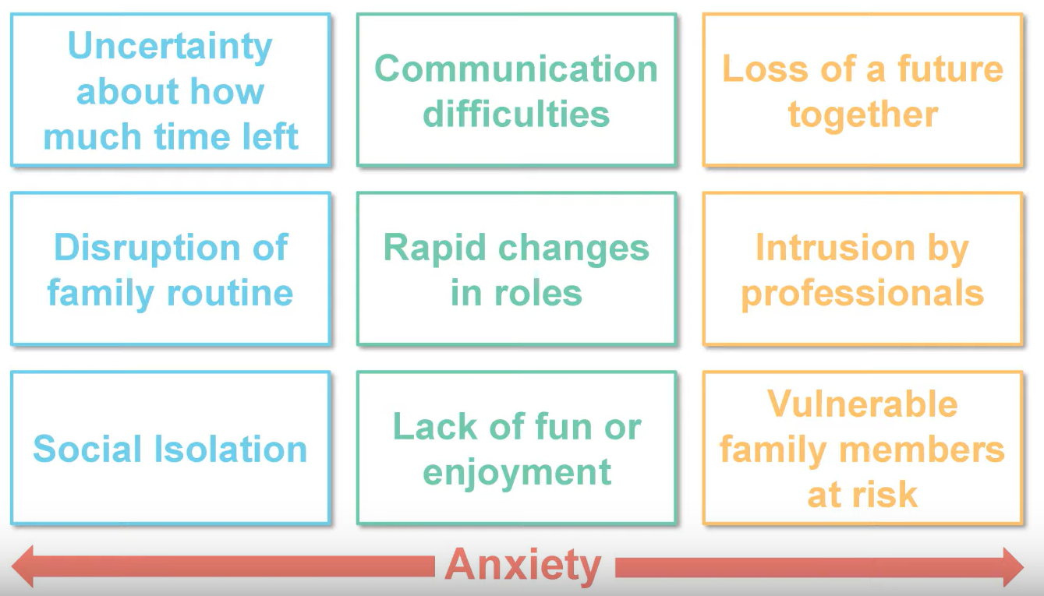
The effects of living with a
serious illness in the family
Winston's Wish
Notes:
Pre bereavement stage:
Uncertainty about how much time left – creates anxiety for children and family as a whole.
Distribution of family routines – suddenly natural routines are disrupted.
Social isolation – happening every day, especially with a relative with a life limiting illness.
Communication difficulties – possible communication breakdowns.
Rapid changes in roles – children may have to step up (might have to help with meals or looking after siblings).
Lack of fun or enjoyment – difficult for children living with a relative with a life limiting illness to actually find any joy or fun in life.
Loss of a future together – thinking about what it might be like in the future not to have that really important person in their life (whether a parent, sibling, Grandparent, Aunt, Uncle etc).
Intrusion by professionals – more people involved in the family i.e. social care, hospice care, doctors/nurses, more phone calls which may cause more anxiety in the house.
Vulnerable family members at risk – all this creates more anxiety.

Slide 14
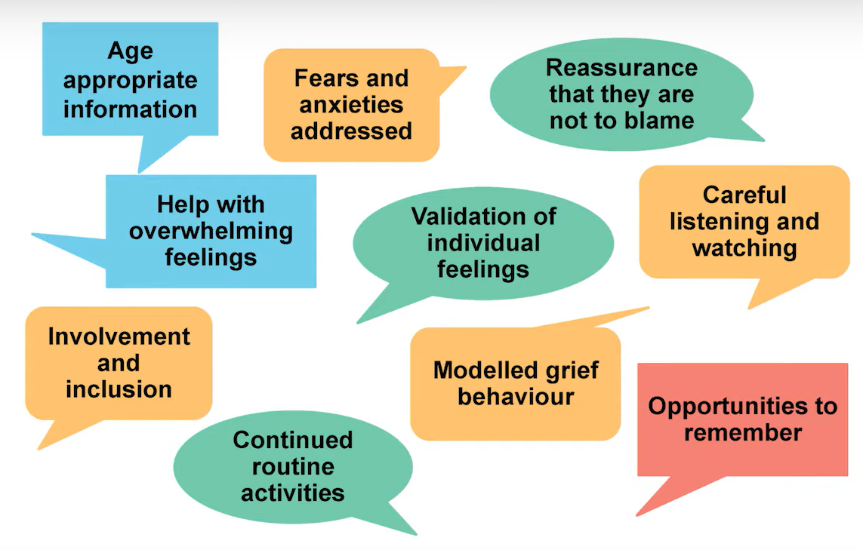
What bereaved children need
Winston's Wish
Notes:
Group discussion – what else might children need? What do children need from their school/college?

Slide 15
L.E.N.D
Notes:
L.E.N.D is an acronym that was developed by St Luke’s when it launched Compassionate Communities in 2017-2018.
Explain what L.E.N.D stands for – Listen, Empathise, Notice and Do. The next few slides will demonstrate how the L.E.N.D model links to schools and colleges.

Slide 16
Break
Notes:
Break

Slide 17
As a Compassionate Friend you
L.E.N.D
Listen – to help people to talk over what they need, their worries or what they want to do
Empathise – to acknowledge their situation and respect their choices
Notice – when someone may need some company, to have a chat, a helping hand or when they don’t!
Do – by giving practical support, signpost to services and resources, work with others to be a compassionate community
Notes:
Explain in further detail what L.E.N.D stands for:
Listen – to help people to talk over what they need, their worries or what they want to do.
Empathise – to acknowledge their situation and respect their choices.
Notice – when someone may need some company, to have a chat, a helping hand or when they don’t!
Do – by giving practical support, signpost to services and resources, work with others to be a compassionate community.

Slide 18
L is for LISTEN
Listen to help people to talk over what they need, their worries or what they want to do
Notes:
Listen to help people talk over what they need, their worries or what they want to do.

Slide 19
What makes a good listener?
Doesn’t interrupt
Is patient
Has good and appropriate eye contact
Uses reassuring nods and mirroring of body language
Uses open questions
Be aware of self and culture of the other person, and their level of understanding
Comfortable with silence
Paraphrase and reflect back
Conversations should always be voluntary and confidential (unless concerns re safeguarding)
Give information and reassurance but NOT advice
Notes:
Discuss each one briefly and ask the group of their thoughts.

Slide 20
Why can listening be more difficult when having a conversation with children and young people about death and dying?
Notes:
Small activity - in pairs or small group to talk about why listening can be more difficult. This may start evoking comments such as – it being a taboo subject. Having conversations about death with a child can be difficult. Worried about how much they will understand or how they will react. However, emphasis that speaking honestly can help children feel supported. An opportunity to talk about:
What’s important to them.
What they need to feel more comfortable.
If they have any worries or concerns about the future.
Everyday issues, news and interests to help then feel a sense of normality.
Their loved one - giving them an opportunity to share memories as this helps with the grieving process.

Slide 21
‘It is very doubtful that we will look back and say it was wrong to talk directly and openly to children about difficult things’
Notes:
Emphasise that ‘It is very doubtful that we will look back and say it was wrong to talk directly and openly to children about difficult things’.

Slide 22
E is for Empathise
Empathy is the ability to see a situation from the other person’s point of view.
It's about staying alongside them, supporting them through their experience and allowing them to express what they are feeling in their own way.
Remember: IT'S ALL ABOUT THEM, NOT YOU
Notes:
Empathy always begins with good listening.
Changes in the child’s behaviour needs to be responded with empathy, support and understanding during the stressful time while the child tries to adjust to the huge absence in their life.
Your caring presence and the words ‘I’m so sorry’ with a hug or touch of a hand will give authentic expression to what is needed. Remembering and honouring their loved one’s memory such as their birthday or anniversary of their death.

Slide 23
What is Empathy
Brene Brown
Notes:
Watch video – what are people’s thoughts?

Slide 24
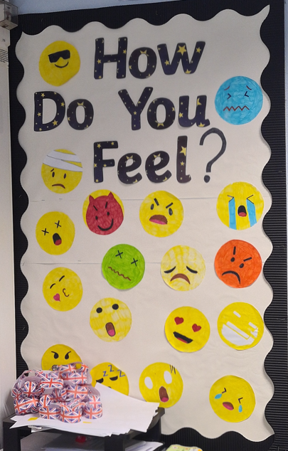
N is for Notice
Notice when someone wants your help, to talk or don’t
Change in behaviour
Absences from school
Anxiety, emotions, inappropriate language
Homework not being completed
Body language
Notice a change with parents, siblings
Notes:
N is for Notice
Notice when someone wants your help, to talk or don’t.
Change in behaviour.
Absences from school.
Anxiety, emotions, inappropriate language.
Homework not being completed.
Body language.
Notice a change with parents, siblings.

Slide 25
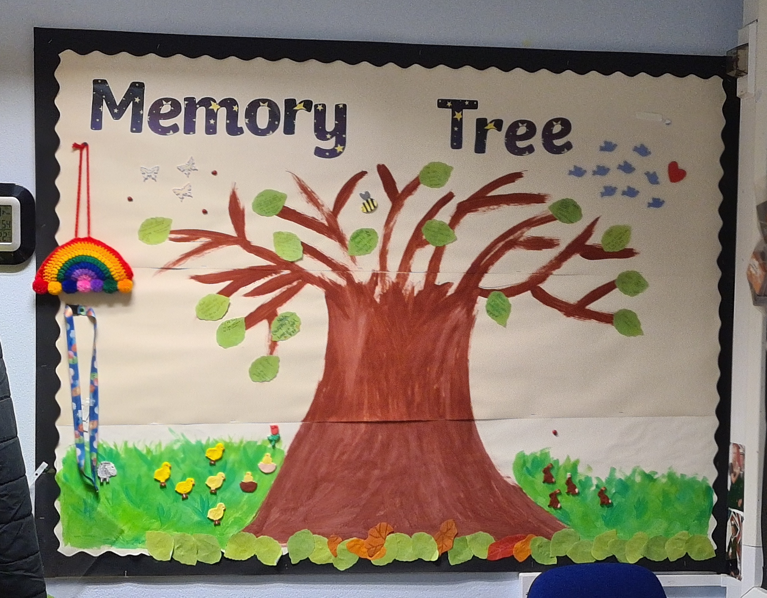
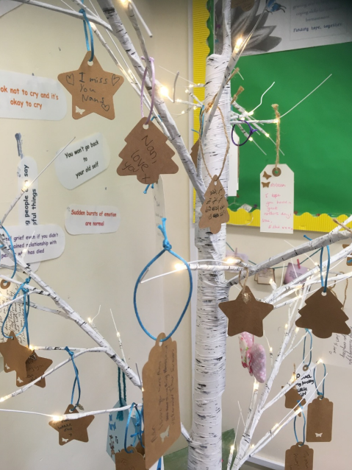
D is for Do
Ways to alert a teacher
Safe space
Starfish stickers
Memorial place
Compassionate Buddies
Good grief clubs
Forum Theatre
Signpost
Notes:
D is for Do - ways to alert a teacher, safe space, starfish stickers, memorial place, Compassionate Buddies, Good grief clubs, Forum Theatre, signpost etc.

Slide 26
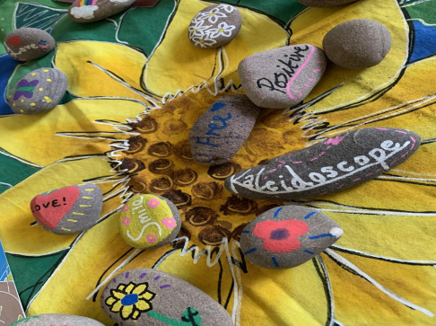
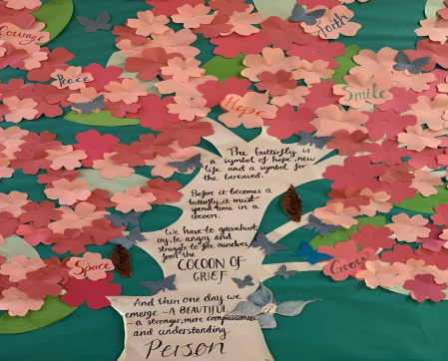
How schools/colleges can support bereaved pupils
Most grieving pupils do not need a ‘bereavement expert’, they need people who care. Schools, just by carrying on with their usual day-to-day activities, can do a huge amount to support a grieving pupil. By gently introducing death and grief into the classroom the fear is removed, and young people will develop coping skills should someone they know die now or in the future.
Normality
A listening ear
The opportunity to be a child/adolescent
Be proactive
Keep in contact with home
Transition
Child Bereavement UK
Notes:
Normality – routines of school life can offer a sense of security and continuity.
A listening ear – schools can provide an opportunity to talk about what has happened with a familiar and trusted adult in a peace and calm environment.
The opportunity to be a child/adolescent - even when deeply sad, children still need to be children. School offers the chance to play, laugh, sing and generally just be a child without feeling guilty.
Be proactive – have a selection of resources available i.e. books as these are a wonderful way to gently introduce the conversation of death and dying.
Keep in contact with home -good communication with home will help your school to be aware and have a more realistic picture of how the child is coping.
Transition – it is helpful for information to be passed about the pupil’s circumstances, so they do not need to repeat their story at each transition point.

Slide 27
Compassionate Schools
Notes:
Watch video.

Slide 28
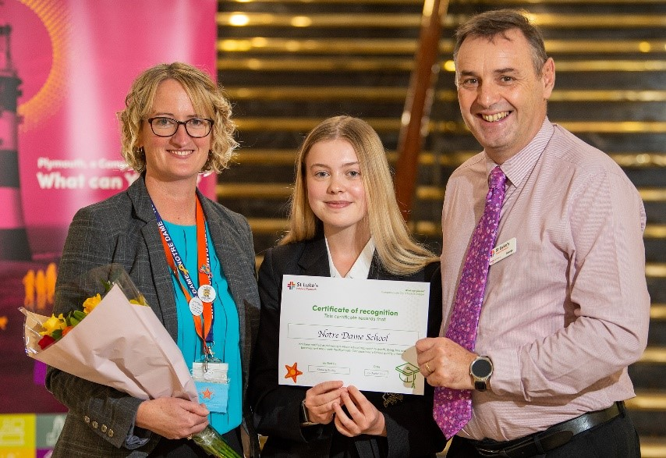
7 steps to become a recognised Compassionate School
1. Schools will have compassionate buddies, friends
and champions scheme
2. Death and loss will not be a taboo subject in
school settings
3. Schools to have a policy on how to inform and
Support pupils and/or colleagues about a death
or disclosure of a terminal illness
4. Staff have access to anticipatory grief and bereavement training and can demonstrate an understanding of the school’s policy on how to inform and support pupils and/or colleagues about a death or disclosure of a terminal illness
Notes:
1. Schools will have compassionate buddies, friends and champions scheme.
2. Death and loss will not be a taboo subject in school settings.
3. Schools to have a policy on how to inform and support pupils and/or colleagues about a death or disclosure of a terminal illness.
4. Staff have access to anticipatory grief and bereavement training and can demonstrate an understanding of the school’s policy on how to inform and support pupils and/or colleagues about a death or disclosure of a terminal illness.

Slide 29
7 steps to become a recognised Compassionate School
5. Schools should be able to demonstrate emotional and practical ways to support students with anticipatory grief and those bereaved
6. Monitoring and evaluation
7. Schools will publicise their Compassionate School support and
information
Notes:
5. Schools should be able to demonstrate emotional and practical ways to support students with anticipatory grief and those bereaved.
6. Monitoring and evaluation.
7. Schools will publicise their Compassionate School support and information.

Slide 30
Notes:
Watch video.

Slide 31
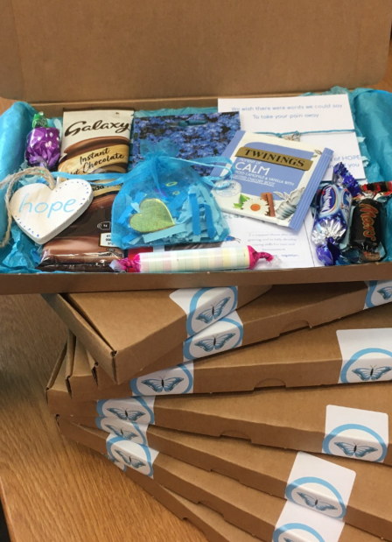
Looking after yourself (staff)
Being alongside anyone experiencing a loss can be emotionally draining but supporting a bereaved pupil particularly so. The need for support for yourself is not a sign of an inability to cope or of professional incompetence, but a recognition that everyone needs help to carry out this demanding role.
Share feelings
Anticipate that you may experience an emotional reaction
Professional boundaries
Have information on resources and organisations
Help others
Try to recognise when you are running on empty
Notes:
Share feelings - talk to colleagues about how you are feeling and share experiences ( to feel less alone and better able to cope).
Anticipate that you may experience an emotional reaction – its normal and OK to be emotionally affected. You may become aware of previous losses in your own life that might resurface. It’s not a sign of weakness, but a recognition that we all have our limits.
Professional boundaries – when working in a school environment, it is very easy to let the carer in us take over and forget professional boundaries. Getting over involved is not helpful to you or the bereaved pupil or adult. Remember you can’t carry their grief for them, but you can be alongside them.
Have information on resources and organisations – have a signpost list available or organisations etc, books and resources.
Help others – if you become aware that a colleague is stressed or affected by a death in your school community or know they have experienced a bereavement themselves, try to find the time to offer them your support.
Try to recognise when you are running on empty - make time to something just for you or give yourself a treat. Physical experience can be a great stress buster!

Slide 32
Well Done! You are now a Compassionate Friend!
Community Development Team
St Luke’s Hospice Plymouth
community.development@stlukes-hospice.org.uk
Notes:
End

